Slide 1

The Boeing Company
an Aerospace company

Slide 2

Introduction to Entrepreneurship and the economy
The importance to entrepreneurship is it brings economic growth by creating new jobs, opportunities, inspiring new ideas, and innovation to products, and services, and in doing so increasing the convivence and ease in life.

Slide 3

Company Importance
The economy was affected quite harshly because of the boing company. People who specialize in economics say that there was/is a pull-on growth from Boeing at about .25 percent in the second quarter. According to some financial advisors on economics from the Whitehouse, Boeing’s troubles cut gross domestic product from march-June by .4 percent.

Slide 4

My influential company
The reason why I chose this company is because of its position in the Aerospace market, being the best in that market. And it being the top company in the aerospace market its effect in the economy is very big. If the company goes down, then the economy gets hit and if the company does good the economy stays the same in a good way.

Slide 5

The Boeing companies' history
The founder of The Boeing company is William E. Boeing
Boeing mission is to “To connect, protect, explore, and inspire the world through aerospace innovation.”
Boeing core services and production is commercial airplanes, defense products and space systems

Slide 6
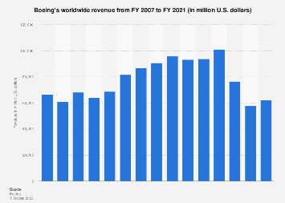
Economic Impact
Around 70 percent of commercial airplane revenue comes from foreign customers, while over 90 percent of their total workforce and 80 percent of their supply chain are in the United States.
Boeing’s market helps create high value aerospace jobs throughout its supply chain furter more Boeing works with more than 12,000 businesses supporting more than 1 million supplier related jobs across the United States.
Boeing also contribute 1% to GDP

Slide 7
Entrepreneurial Strategies
Boeing's economic growth has been driven by entrepreneurial strategies stemming from its founders' and leadership team's visionary approach. These strategies include a relentless focus on technological innovation, pioneering aircraft designs, and a commitment to excellence in aerospace manufacturing. Boeing's ability to adapt to changing market dynamics, establish global partnerships, and invest in research and development has been instrumental in fostering economic growth. The company's historic success can be attributed to its founders' entrepreneurial spirit and its leadership team's dedication to pushing the boundaries of aviation, ensuring sustained economic impact.

Slide 8

Innovation
Boeing's groundbreaking plane, the 747, and Dreamliner have established its place in the industry. Besides making planes Boeing invests in research, development, and sustainability, driving technological progress and creating valuable jobs. This commitment to innovation expands Boeing's global economic influence on massive proportions

Slide 9

Part 5: Reflection and Discussion

Slide 10
Reflection
Throughout the project we learned about the relationship between Entrepreneurs and the economy boost economic growth and innovative with products, and services.
Some challenges and opportunities entrepreneurs face in today's landscape are oversaturated market making it hard to stand out unless you have a unique idea that which may benfit a bussiness.

